Slide 1
Capstone Presentation Showcase
Intern Project Presentation Overview
Global Intern Program
Summer 2022
(1 June 2022 – 26 July 2022)
By Rajneesh Pandey (rajnepan)

Slide 2


Topics for Presentation Showcase
Overview & goal of the project
Approach taken through the project
Accomplishments and deliverables
Biggest challenges
Lessons Learned
Next Steps
Q&A

Slide 3
Anomaly Detection Tool
Detect and Annotate Anomalies in Time Series Data
Rajneesh Pandey
Project Intern – Server Technology, OCI

Slide 4

Anomaly Detection Tool Rajneesh Pandey
Project Overview
Context:
This tool helps to detect and annotate anomalies in Time Series Data and integrating it with the ART tool.
Scope of project:
Monitor any data source, including user logs, devices, networks, and servers. Rapidly identify zero- day attacks as well as unknown security threats. Find unusual behaviours across data sources that are not identified when using traditional security methods.
Objectives:
Reduce time for the annotator to go though all the dataset and annotate the anomalies.

Slide 5
Approach & Process
Understanding of Annotation Review Tool, how to use it and set it up in my system.
Understanding of tagAnomaly tool, Time Series data etc and set it up in my system.
Documented all the information.
Did the POC on the Point Selection on graph using PlotlyJS and ChartJS.
Building the AD tool similar to tagAnomaly using ReactJS and PlotlyJS.
Integrating the AD tool in ART tool.
Enabling import and export feature.
Accomplishments & Deliverables
Successfully build the AD tool and Integrating it to the ART tool.

Slide 6
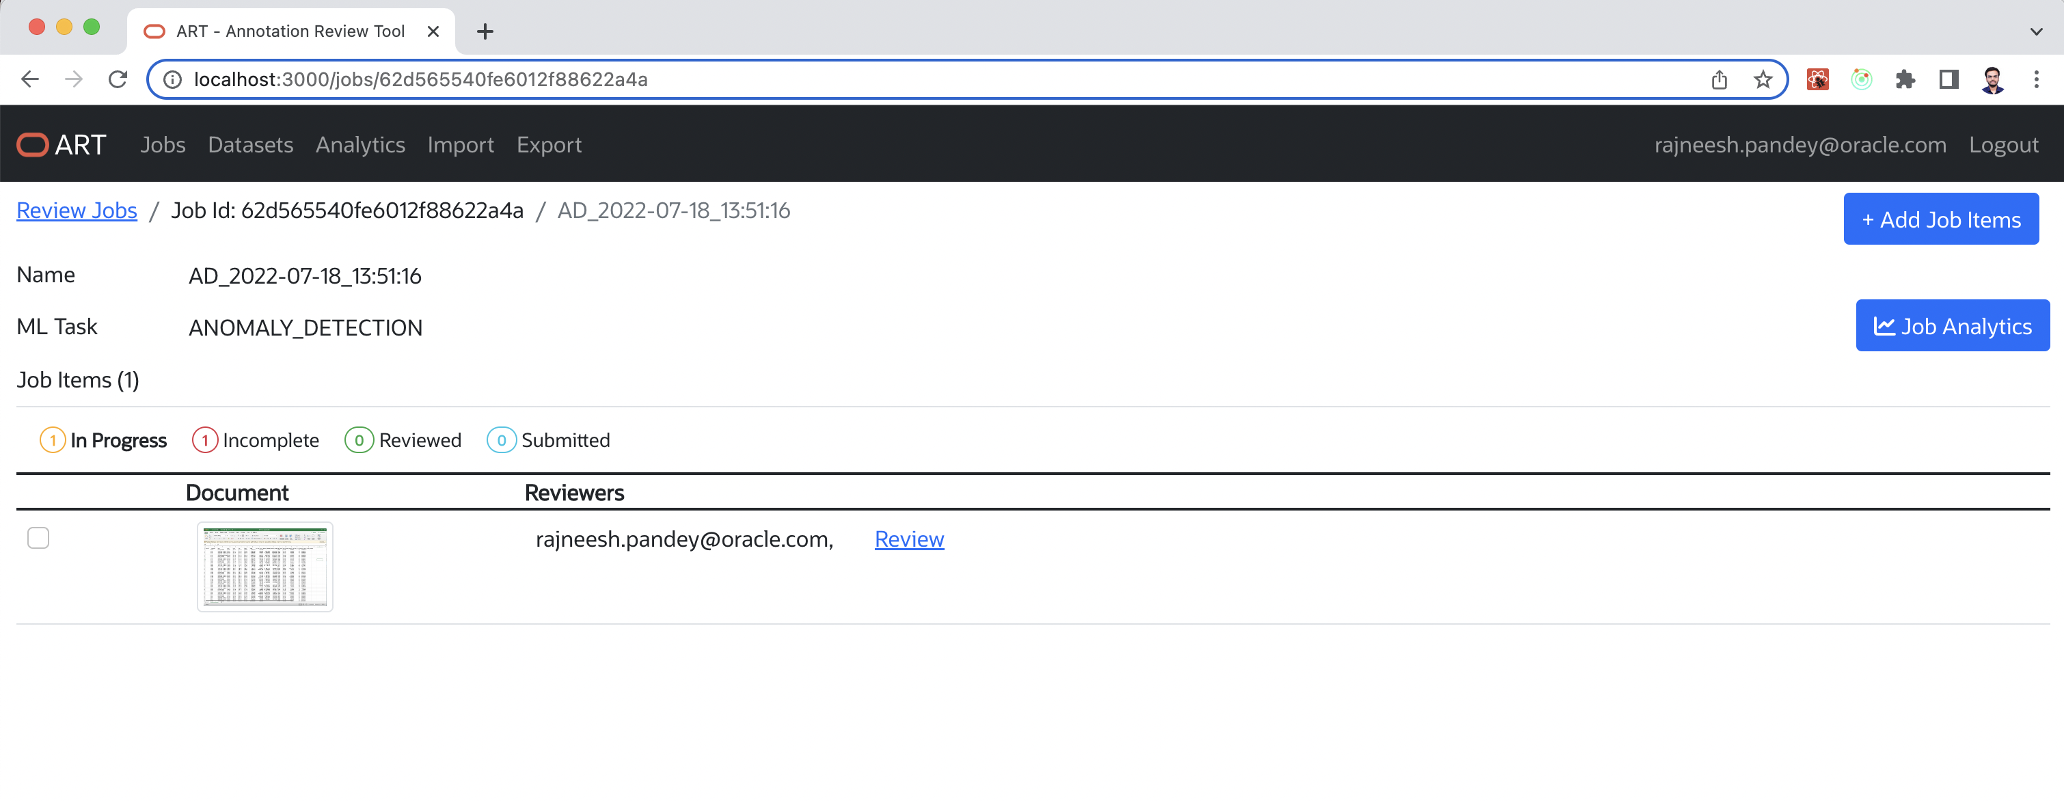
Demo Space

Slide 7
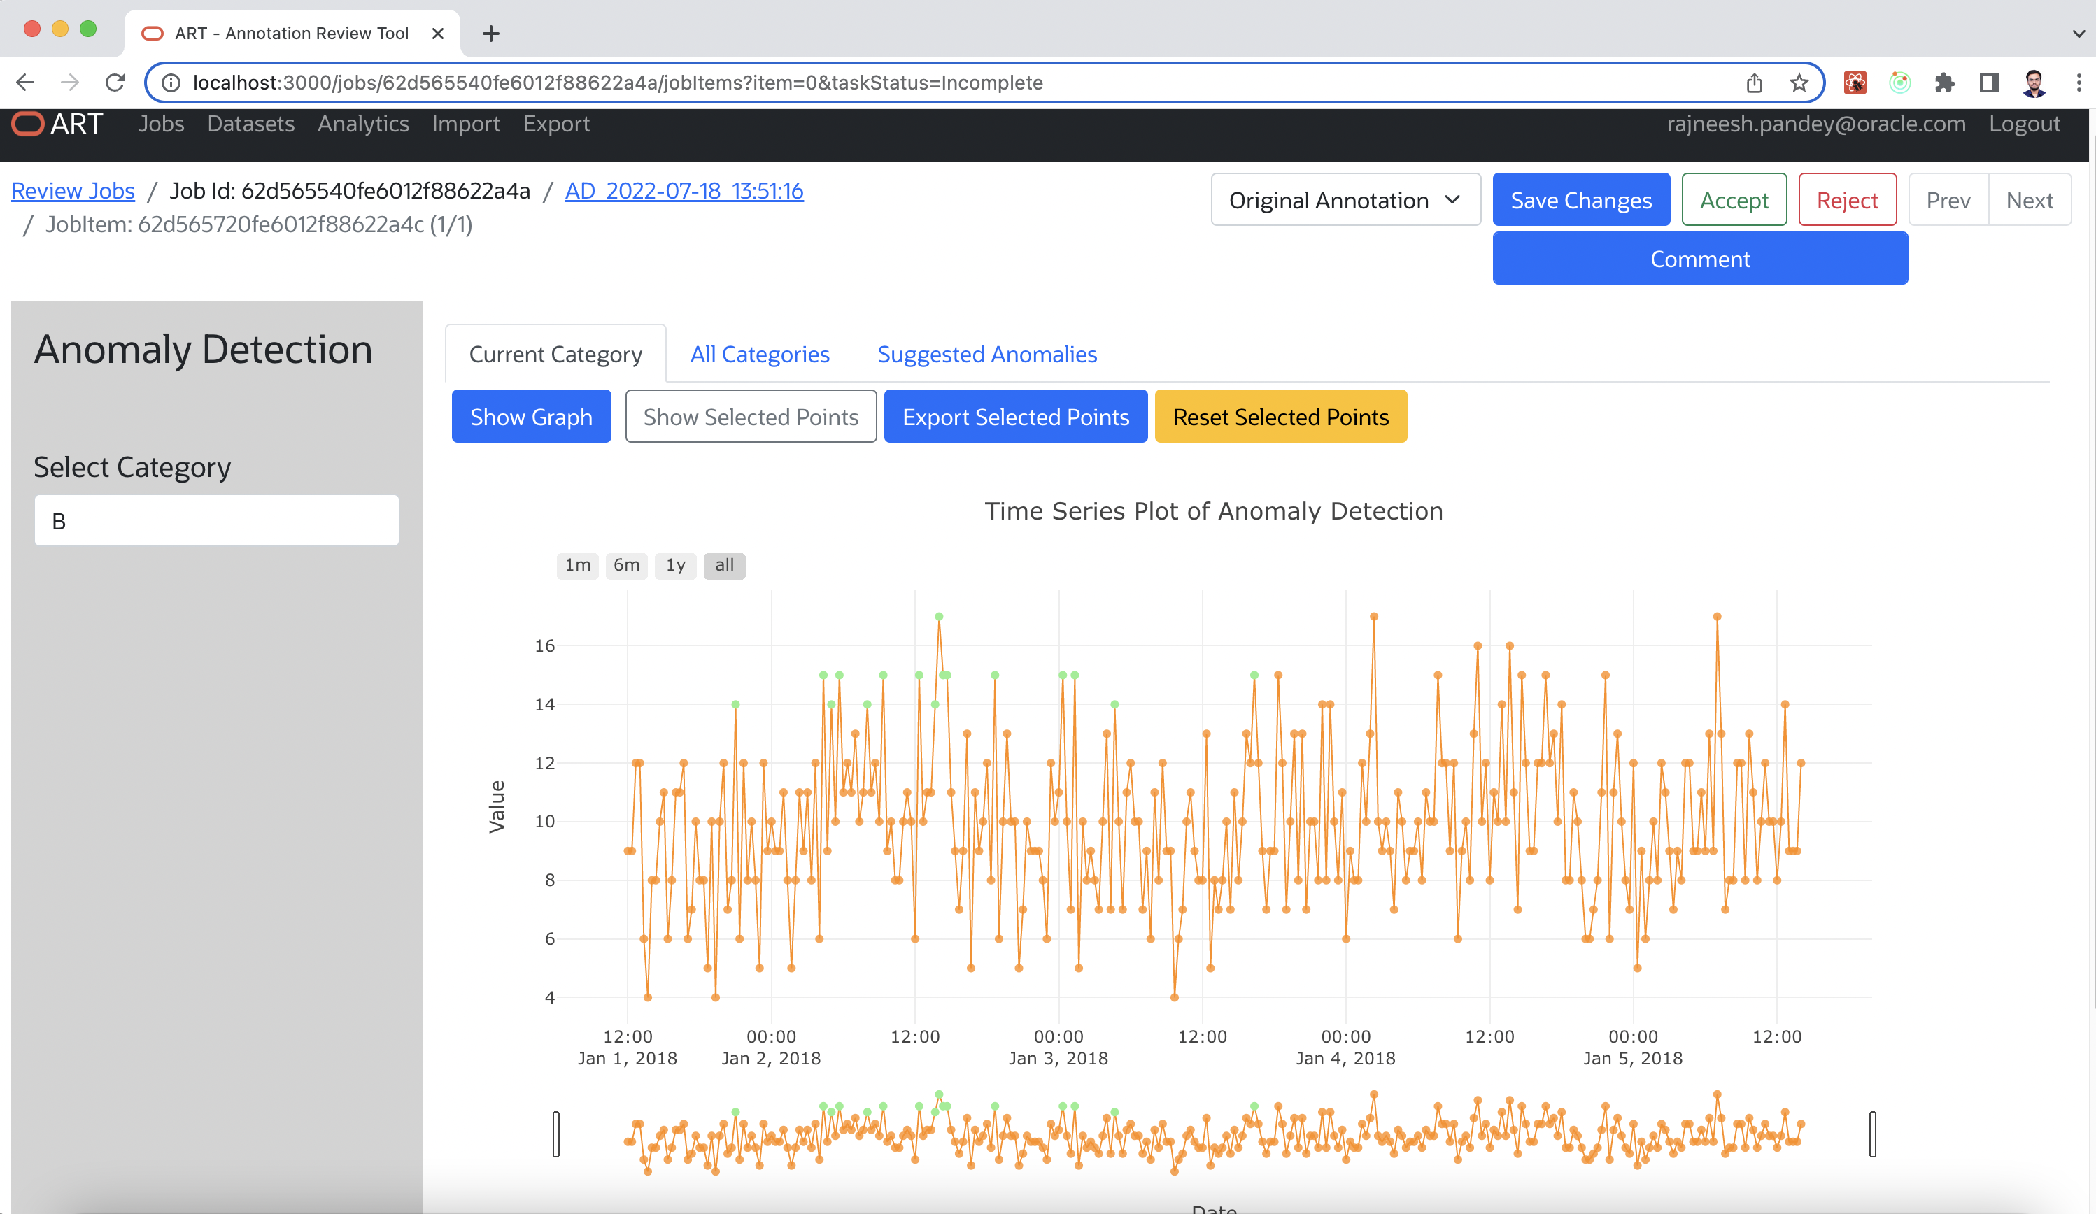

Slide 8
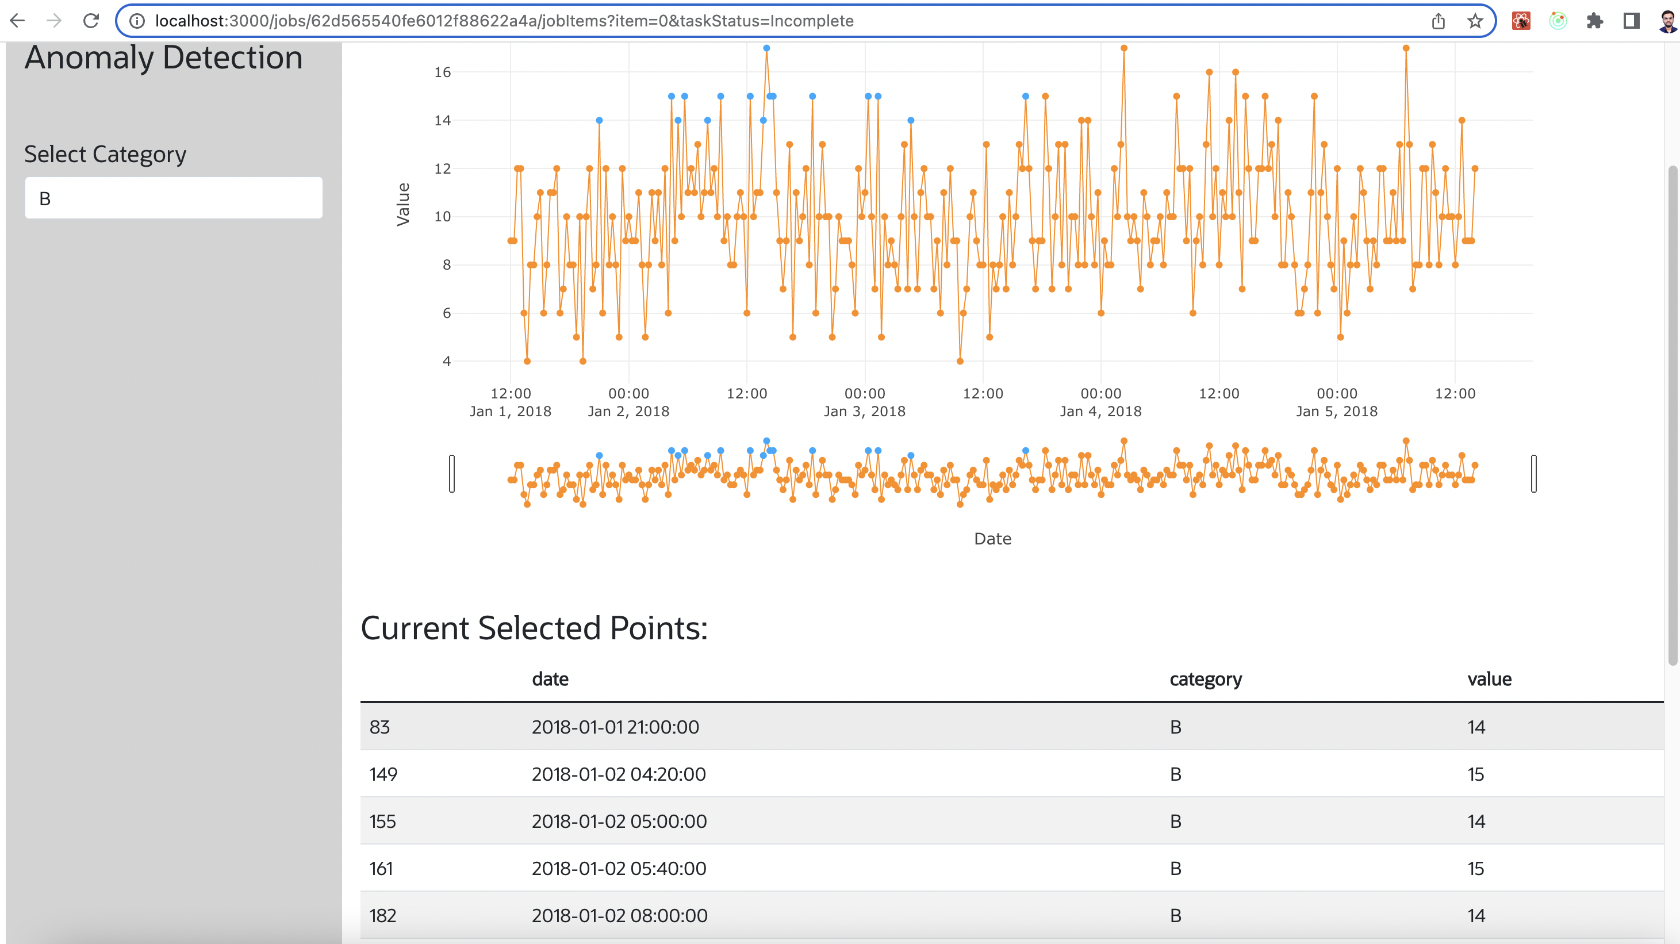

Slide 9
Biggest Challenges
Points selection in graph rendered when implemented with ReactJS.
Import and export of data in ART tool for AD.
Next Steps
The Deep/Machine Learning model will be integrating to the AD tool to find the anomalies automatically.
Lessons Learned
ReactJS , Redux, ML/DL algorithm.
ChartJS, PlotlyJS.
Spring Boot.
Internship Highlight
When I integrated AD to ART tool at its start working properly.
Notes:
What could have been done differently in the project
What skills sets were developed

